Slide 1
A decade with Kamo`oalewa: key findings and open questions ahead of the Tianwen-2 mission
Marco Fenucci, ESA NEO Coordination Centre
05/12/2025

Slide 2
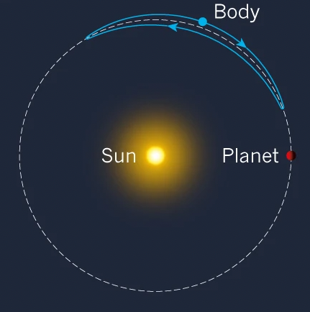
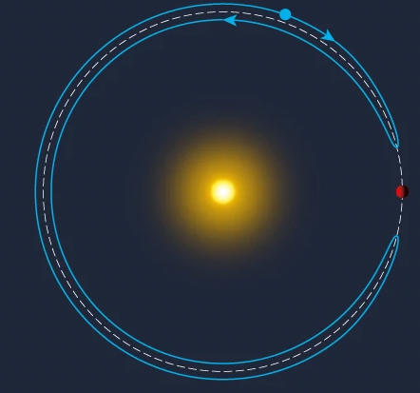
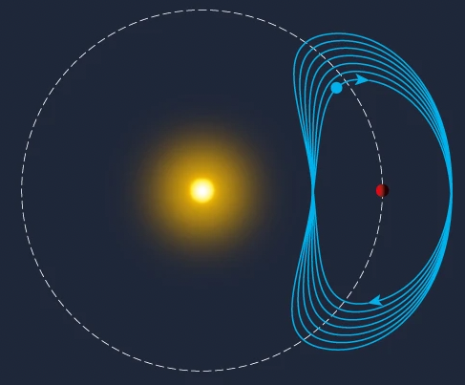
Discovery
Quick facts:
Discovered by Pan-STARRS in 2016
~1 yr orbital period
Quasi-satellite orbit [1]
Mag ~22 in Feb - Apr
Tadpole
Horseshoe
Quasi-satellite
Why is it important?
Unique physical and dynamical properties
Target of the Tianwen-2 mission by CNSA
Fig. 1. Different co-orbital motions: Tadpole, Horseshoe, and Quasi-Satellite.
[1] de la Fuente Marco & de la Fuente Marcos (2016). Asteroid (469219) 2016 HO3, the smallest and closest Earth quasi-satellite, MNRAS 462

Slide 3
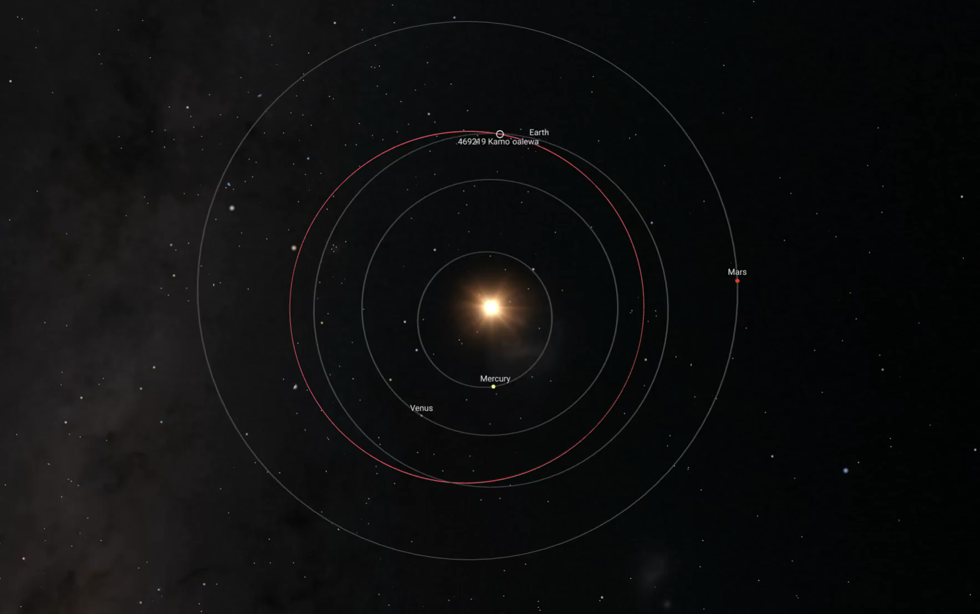
Orbit properties
Credits: ESA NEO Toolkit

Slide 4
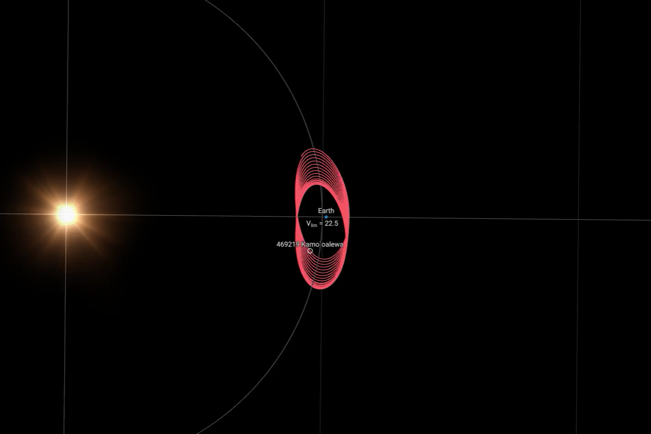
Orbit properties
Credits: ESA NEO Toolkit

Slide 5
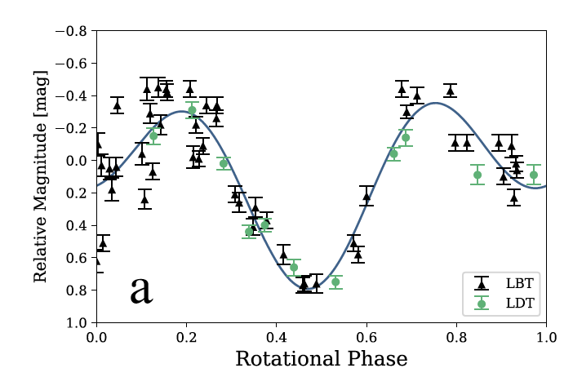
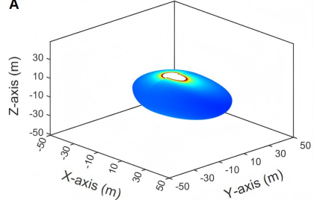
Diameter and rotation period
Diameter
Absolute magnitude ~24
Range of diameter: ~30 m to ~60 m
Rotation period & Shape
Rotation period ~28 min [2]
Shape modeling from lightcurve inversion [3]
Takeaway
Kamo`oalewa is a small fast-rotator with elongated shape
[2] Sharkey et al. (2021). Lunar-like silicate material forms the Earth quasi-satellite
(469219) 2016 HO3 Kamoʻoalewa, Comm. Earth & Env. 2
[3] Zhang et al. (2025). DCAPPSO: A novel approach for inverting asteroid rotational properties with
applications to DAMIT and Tianwen-2 target asteroid, Astronomy & Computing 51
Fig. 2. Lightcurve fit (top panel) and shape modeling (bottom panel).

Slide 6
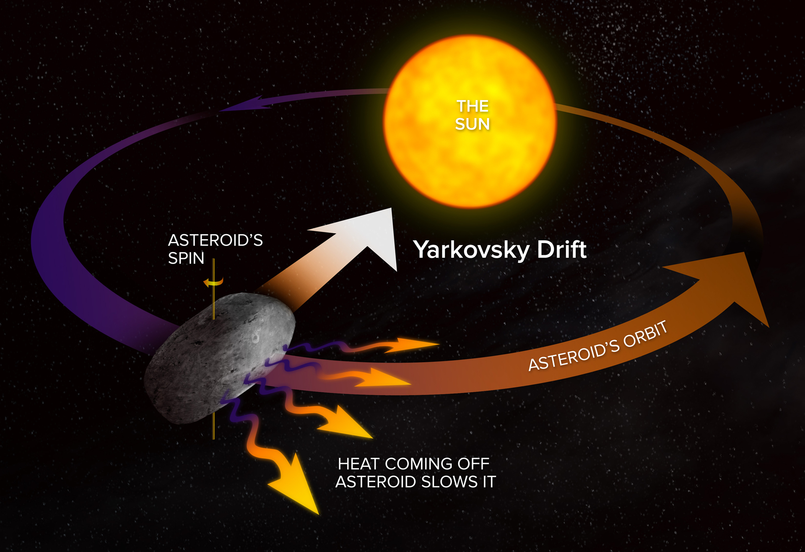
Yarkovsky effect
What is the Yarkovsky effect?
Semi-major axis drift caused by sunlight
Depends on physical properties
Usually tiny: ~10⁻⁴ au/My for ~1 km asteroid
Why it is important?
Better determine the dynamics
Clues about physical properties
How do we determine the Yarkovsky effect?
Orbit determination
Long observational arc to spot a signal
Fig. 3. Schematic representation of the Yarkovsky effect.

Slide 7
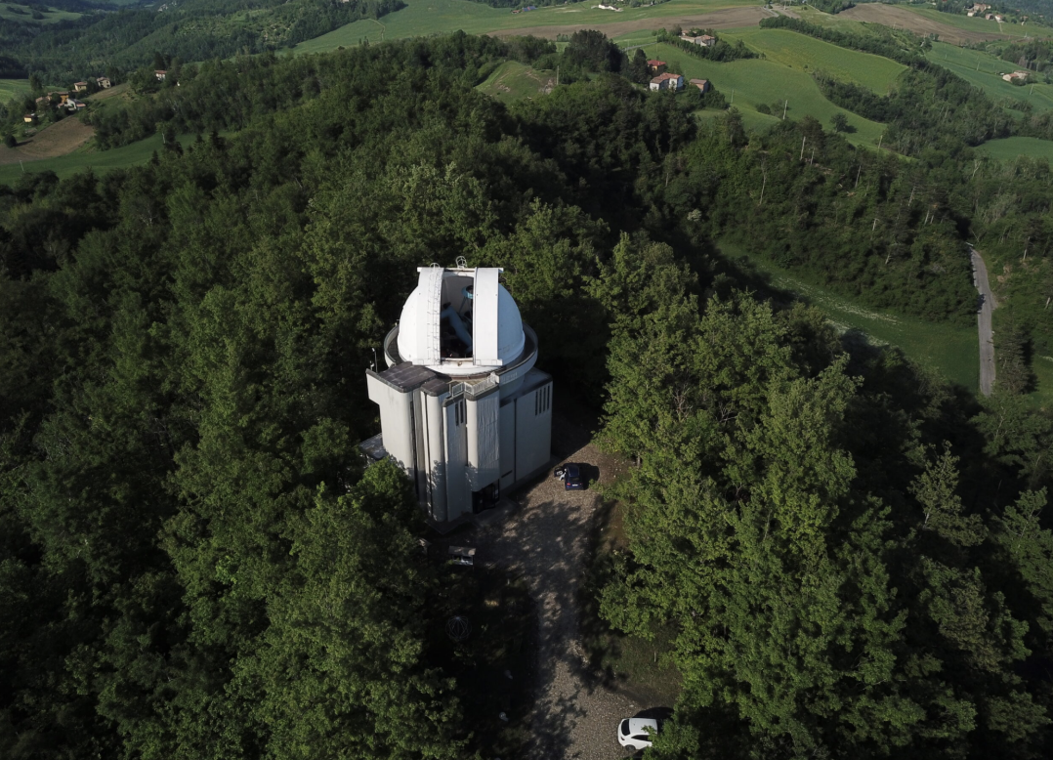
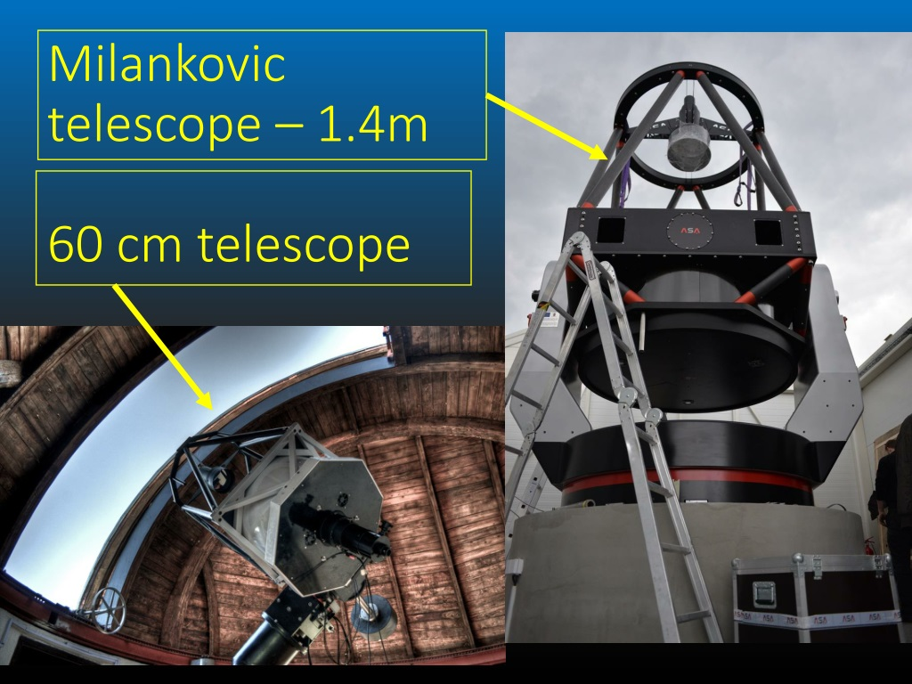
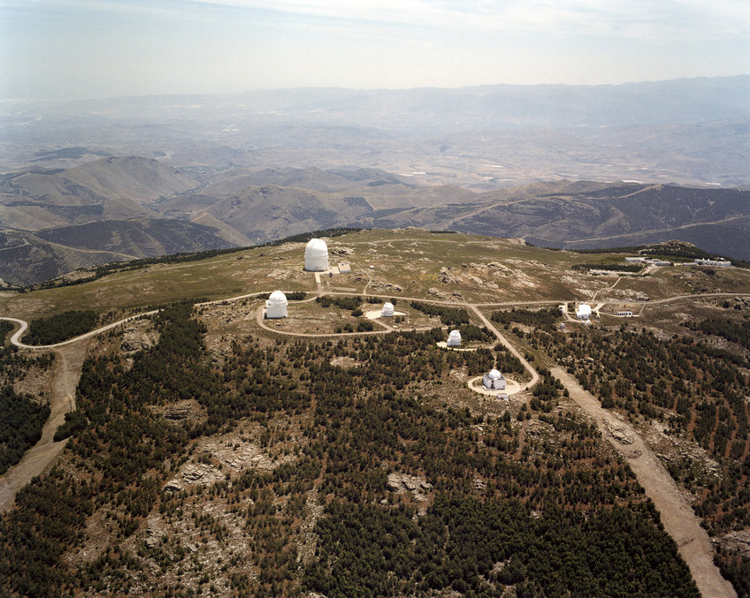
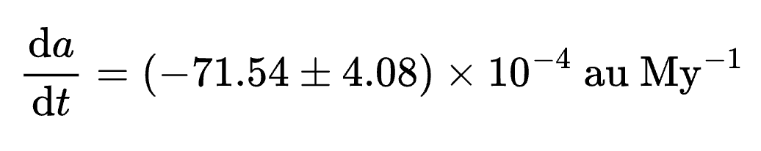
Yarkovsky effect on Kamo`oalewa
Is Kamo`oalewa affected?
Ambiguous signal before 2023
Badly measured observations from 2004
Follow-up work from 2024 [4]:
Remeasured 2004 detections
New observations from Loiano and Calar Alto
Vidojevica was affected by bad weather
New high signal-to-noise Yarkovsky effect determination
Cassini Telescope - 1.5 m
Loiano, Italy
Vidojevica, Serbia
Schmidt Telescope - 1 m
Calar Alto, Spain
[4] Fenucci et al. (2025). Astrometry, orbit determination, and thermal inertia
of the Tianwen-2 target asteroid (469219) Kamo‘oalewa, A&A 695
Fig. 4. Stations participating to the follow-up of Kamo`olaewa in 2024.

Slide 8
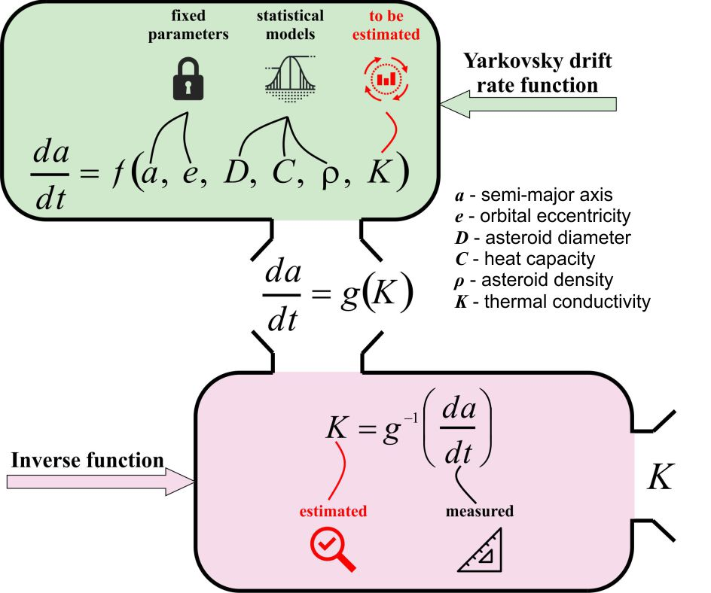
Thermal inertia of Kamo`oalewa
ASTERIA model [5]:
[5] Novaković et al. (2024). ASTERIA – Asteroid Thermal Inertia Analyzer, PSJ 5

Slide 9
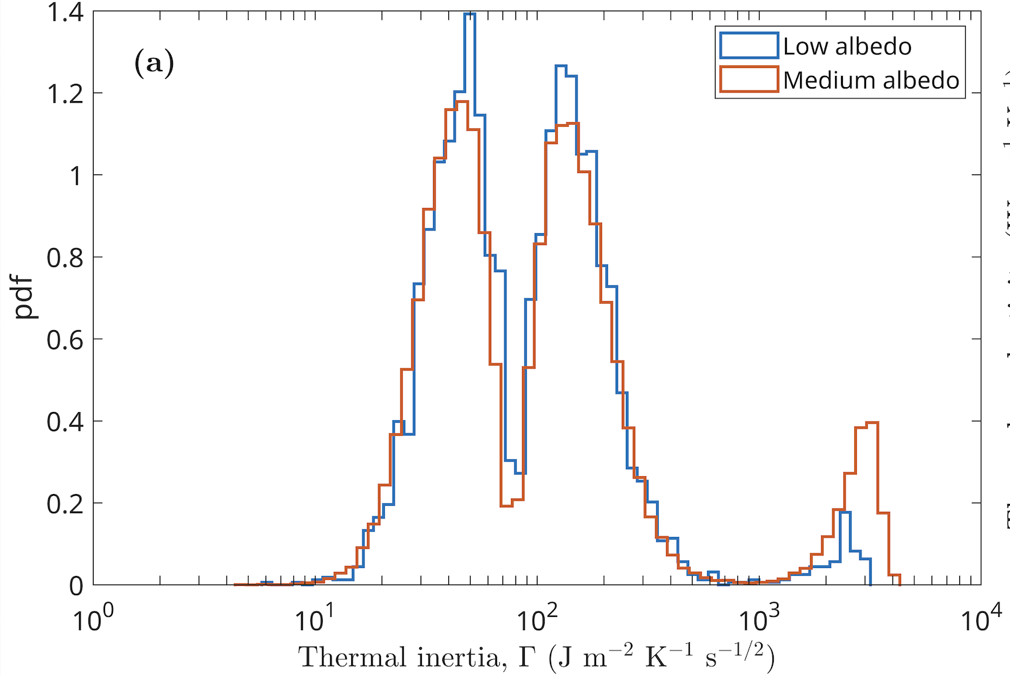
Thermal inertia of Kamo`oalewa
Thermal inertia from ASTERIA model [4]:
Takeaway
Kamo`oalewa has relatively low thermal inertia
Questions
What is the cause?
Regolith on the surface?
Rubble-pile structure?
Microfracturing of the suraface?
TI best estimate: 150₋₄₅⁺⁹⁰ J m⁻² K⁻¹ s^{-½}
[4] Fenucci et al. (2025). Astrometry, orbit determination, and thermal inertia of the Tianwen-2 target asteroid (469219) Kamo‘oalewa, A&A 695

Slide 10
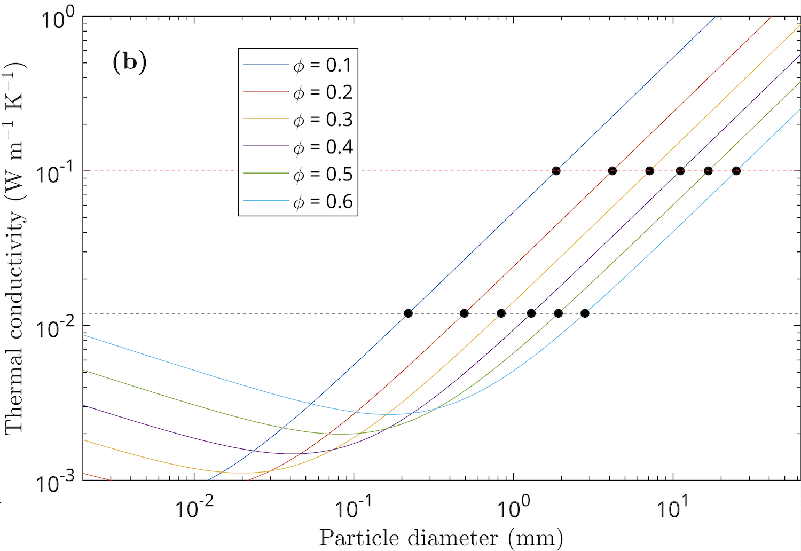
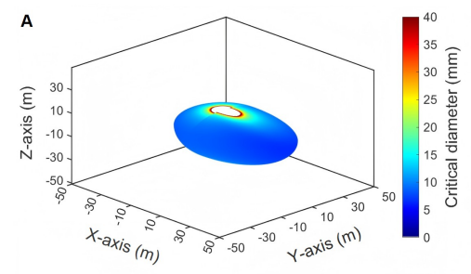
Possible regolith on the surface
Method 1
Method 2
Fig. 5. Extrapolated regolith diameter from thermal inertia estimation (black dots).
Fig. 6. Critical regolith diameter from shape modeling and force analysis.
Takeway
Regolith may be possible
Question: what’s on Kamo`oalewa’s surface?

Slide 11
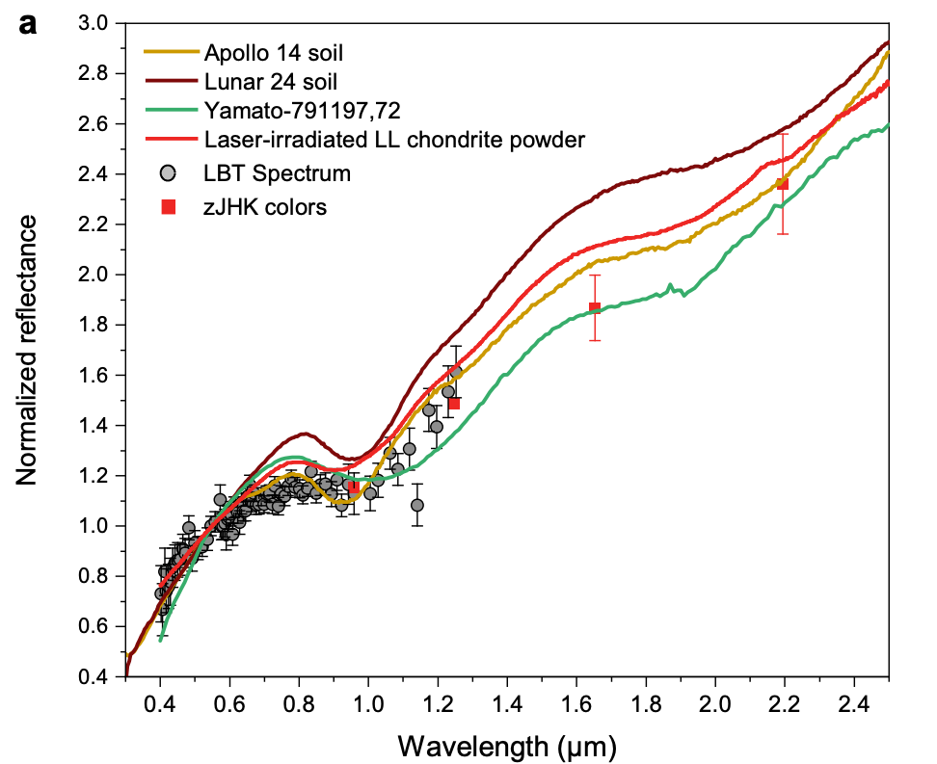
Spectrum
Available observations
VIS-NIR spectrum and zJHK colors
High slope at long wavelength
Comparisons
Similarity with Lunar samples
Similarity with laser irradiated LL-chondrite powder
Takeaway
Spectrum appears strongly space weathered but confirmation is needed
Question
What is Kamo`oalewa’s origin?
Fig. 7. Spectrum of Kamo`oalewa (gray and red points), together with lunar samples spectra (orange, dark red, and green) and laser irradiated LL-chondrite (red).

Slide 12
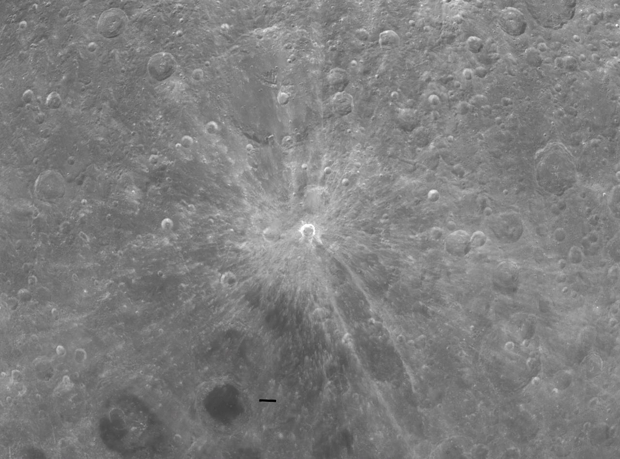
Origin: the Moon hypothesis
Rationale and results [6]
Giordano Bruno crater is the only one large enough with age < 50 Myr
~300 fragments of ~35 m produced by the impact
  1% (95-th pct) become Earth co-orbital
  0.3 – 1 Earth co-orbitals on average
Takeaway
Moon origin is possible, BUT very low probability event
Fig. 8. The Giordano Bruno crater on the Moon.
[6] Jiao et al. (2024). Asteroid Kamo‘oalewa’s journey from the lunar Giordano Bruno crater to Earth 1:1 resonance, Nature Astronomy 8

Slide 13
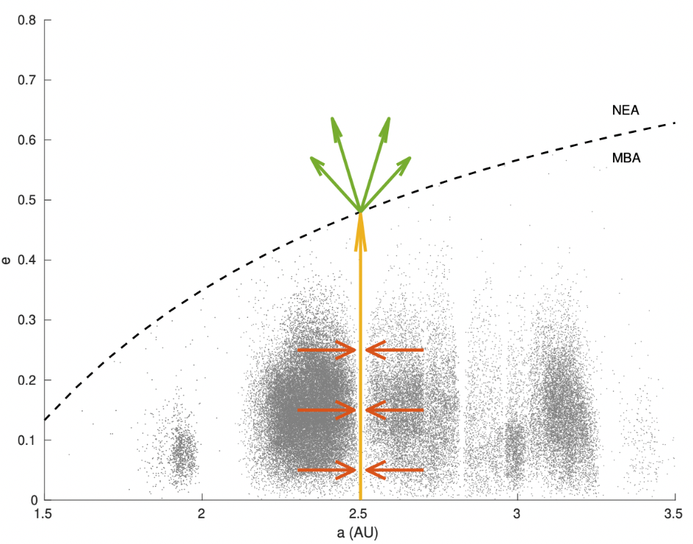
Origin: the main belt hypothesis
Transport mechanism from main belt
Semi-major axis mobility by Yarkovsky effect
Eccentricity increase by resonances
Spread in the near-Earth region
  Planetary perturbations
  Close encounters
Questions
How likely is this scenario?
Which is the parent body?
Fig. 9. Transport mechanism from the main belt to the near-Earth region.

Slide 14
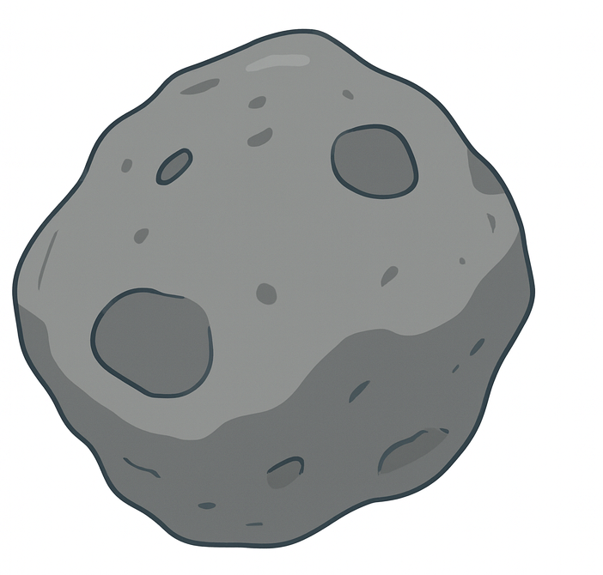
Summary of findings and open questions
✓ Consolidated
❔ Unknowns
Diameter: 30-60 m
Elongated shape
Fast rotator
Yarkovsky effect
Space-weathered surface
Albedo
Surface properties
Internal structure
Origin
Meteorite analogue
⚠︎ To consolidate
Thermal inertia
NIR spectrum
Shape model
Composition
Precise diameter

Slide 15
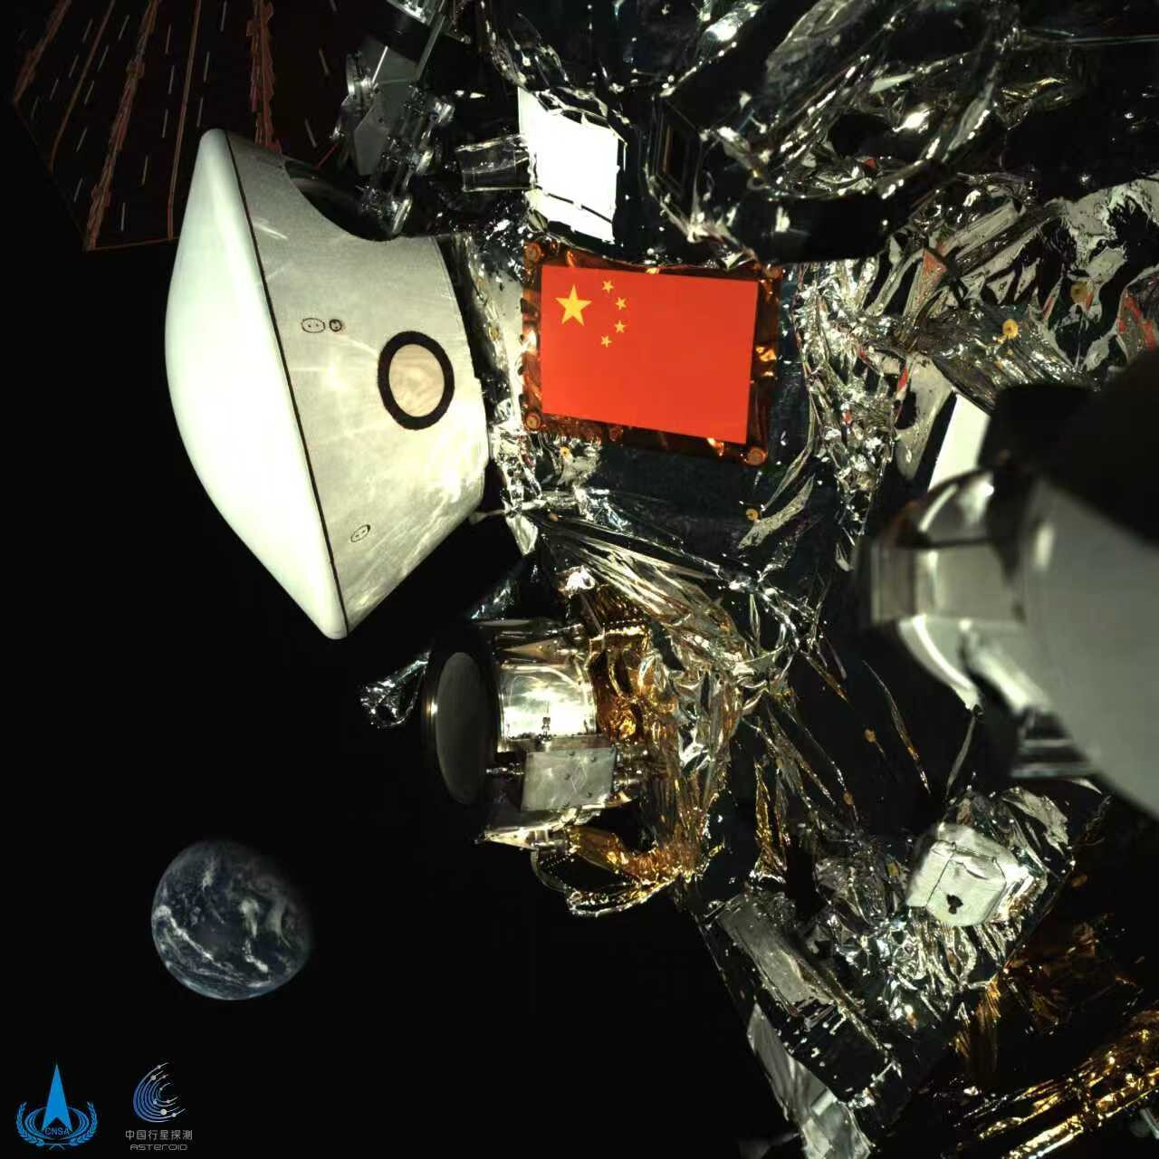
Tianwen-2 mission
Objectives of Tianewn-2 mission by CNSA
Visit Kamo`oalewa and 311P/PANSTARRS
Constrain their dynamics
Full physical characteriztion of the targets
Sample Kamo`oalewa and return it to Earth
Expected schedule
Launch: 28 May 2025
Arrival at Kamo`oalewa: early-mid 2026
Collect sample and return it to Earth: ~ 2027
Journey to 311P/PANSTARRS: ~2030s
Fig. 10. The Tianwen-2 spacecraft with the Earth in the background. Credits: CNSA.

Slide 16
Thank you!
Questions?
Contact: marco.fenucci@ext.esa.int

